Slide 1
Group 1: Intelligent Transportation System
Section 2

Slide 2
Reducing congestion at a 4-way intersection using probabilistic modelling
Domain: Intelligent Transportation Systems
Fixed-time signals fail under random, time-varying traffic
Traffic arrivals, speeds, and queues are inherently stochastic
Motivation: reduce congestion and waiting using probabilistic decision-making

Slide 3
Objective and scope of the project
Objective: Minimize expected waiting time at an intersection
Decision: Select next signal phase and green allocation
Estimated: Arrival rates and congestion levels
Scope: Single isolated 4-way intersection, vehicle traffic only

Slide 4
System Overview
Measure the length / density of queues per approach.
Probabilistically perform model arrivals and clearance.
Approximately pressure on congestion.
Use randomized selection of signal by weight.
Assess through simulation measures.

Slide 5
Sources of Uncertainty
Measurement Uncertainty:
Sensor noise and inaccurate estimation of queues.
Environmental Variability:
Peak vs off-peak traffic
Platoon surges and upstream platooning.
Modeling Uncertainty:
Anciently, poisson assumption might not be true.
Control Uncertainty:
Signal decisions affect the future arrivals and queues (feedback effect).

Slide 6
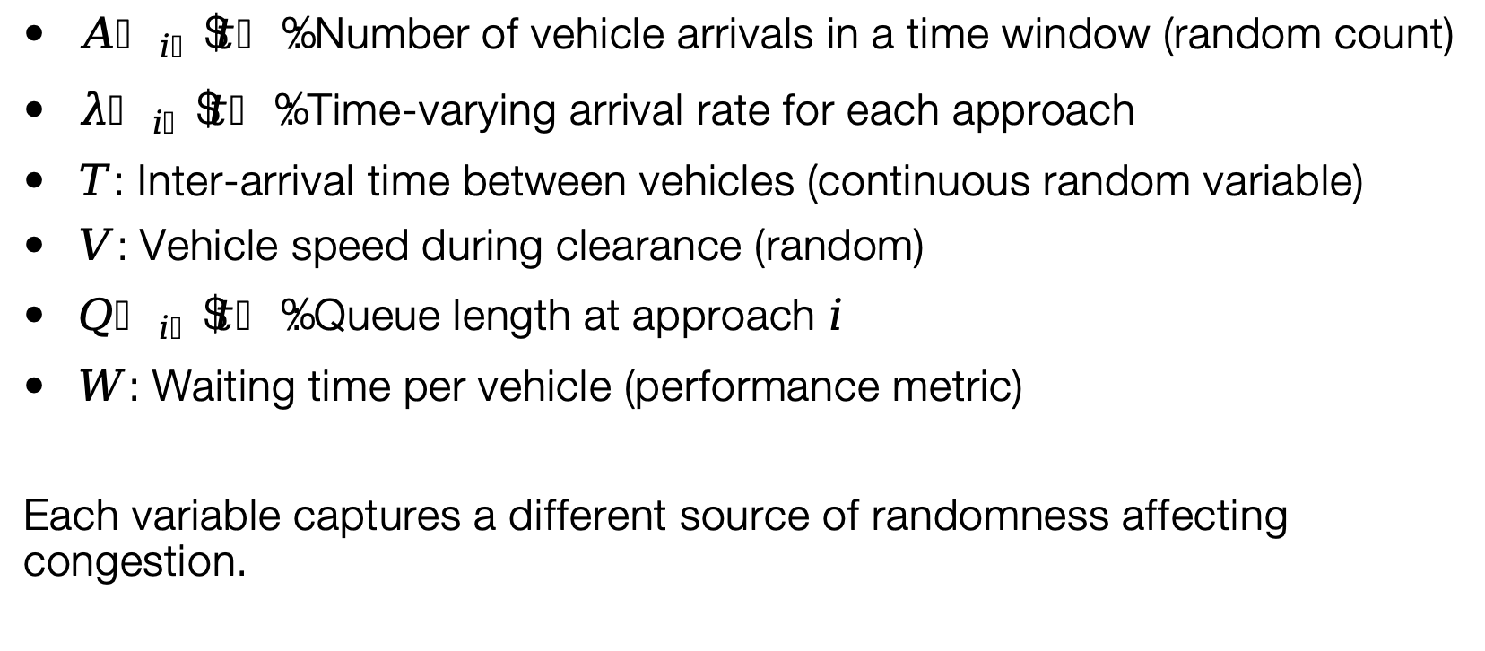
Key Random Variables
$A_{i}\left(t\right)$: Number of vehicle arrivals in a time window (random count)
$λ_{i}\left(t\right)$: Time-varying arrival rate for each approach
$T$: Inter-arrival time between vehicles (continuous random variable)
$V$: Vehicle speed during clearance (random)
$Q_{i}\left(t\right)$: Queue length at approach $i$
$W$: Waiting time per vehicle (performance metric)
Each variable captures a different source of randomness affecting congestion.

Slide 7
Probabilistic Models and Assumptions
Models Used:
Poisson: an arrival of vehicles that is random.
Time intervals between arrivals are exponential.
Normal: variation in clearance speeds.
Assumptions:
Short-run autonomy of arrivals.
Speeds are within an average range.
Small interval approximate stationarity.
Justification:
Brings a sense of realism and simplicity of analysis.

Slide 8
Probabilistic Reasoning/Decision Logic
Random arrivals - uncertainty in the growth of the queue.
The length of queues approximates the risk of congestion.
Increasing congestion - increasing probability of green.
Rational actions are not forecasted but approximated, expected behaviour is considered.

Slide 9
Operationalizing the Reasoning
Algorithm: Randomized Greedy (weight ∝ queue length)
Method: Monte Carlo simulation in Python
Metrics: Expected wait, queue trends, PDF/CDF plots
PDF/CDF used to study typical and worst-case scenarios

Slide 10
Current Limitations
Poisson assumption is weak on platooning.
Freedom could interrupt traffic jam.
No clear fairness/spill back model.
Extreme surges not proven to be stable.

Slide 11
Planned Refinements
Statistically verify assumptions of arrival.
Bursty Arrivals Model and Time-varying λ(t).
Exceeding congestion risk- use Chernoff bounds.
Introduce constraints of fairness and stability.

Slide 12
Summary
Traffic congestion is essentially a stochastic control trouble.
Fixed-time signals are not successful as they do not take into account variability and uncertainty.
Informed adaptive decisions are made by using probabilistic modeling.
Randomized control prevents starvation and reacts to congestion.
Milestone-2 builds on the concept about modeling distributions to reasoning about system behavior, risk and stability.

